Slide 1
User interface design
Lecture 22

Slide 2
Agenda
understand a number of user interface design principles;
several interaction styles and appropriateness;
understand when to use graphical and textual presentation of information;
know what is involved in the principal activities in the use interface design process;
understand usability attributes and have been introduced to different approaches to interface evaluation.

Slide 3
Design issues
How should the user interact with the computer system?
How should information from the computer system be presented to the user?

Slide 4
User interaction styles
Direct manipulation
Menu selection
Form fill in
Command language
Natural language

Slide 5
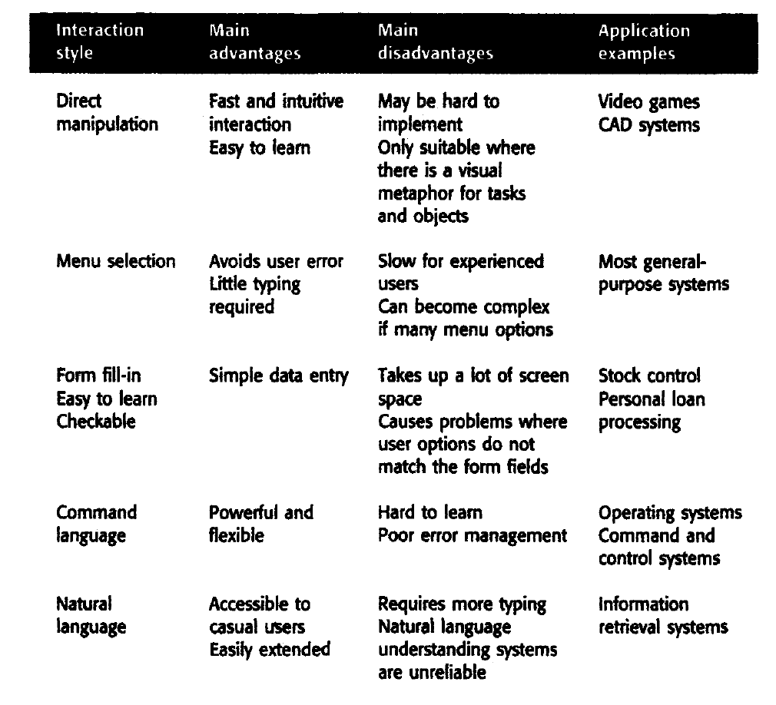

Slide 6
Information presentation
All interactive systems have to provide some way of presenting information to users. The information presentation may simply be a direct representation of the input information (e.g., text in a word processor) or it may present the information graphically.
A good design guideline has to keep the software required for information presentation separate from the information itself.
Separating the presentation system from the data allows us to change the representation on the user s screen without having to change the underlying computational system.

Slide 7
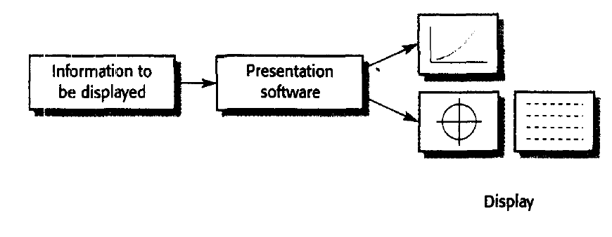

Slide 8
MVC Approach
The MVC approach (Figure 16.6), first made widely available in Smalltalk (Goldberg and Robson, 1983), is an effective way to support multiple presentations of data.
Users can interact with each presentation in a style that is appropriate to the presentation. The data to be displayed is encapsulated in a model object.
Each model object may have a number of separate view objects associated with it where each view is a different display representation of the model.

Slide 9
MVC Approach
Each view has an associated controller object that handles user input and device interaction. Therefore, a model that represents numeric data may have a view that represents the data as a histogram and a view that presents the data as a table.
The model may be edited by changing the values in the table or by lengthening or shortening the bars in the histogram.

Slide 10


Slide 11
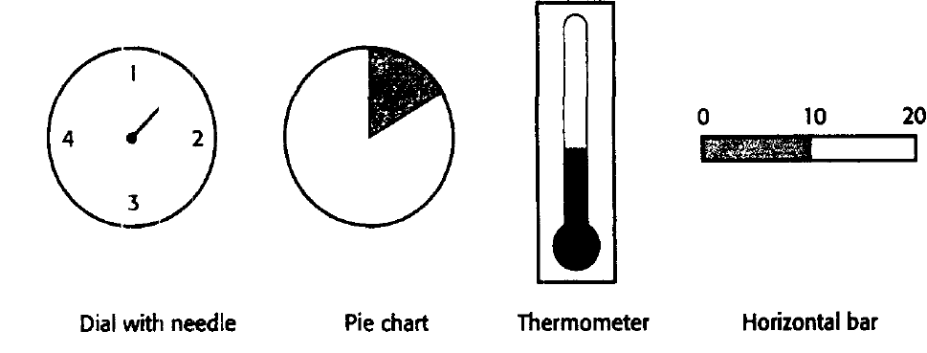

Slide 12
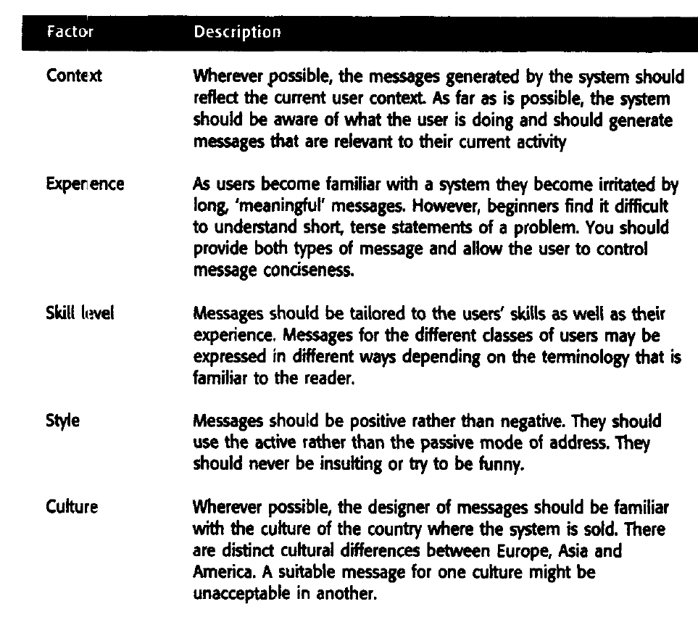

Slide 13
The UI design process
User interface (UI) design is an iterative process where users interact with designers and interface prototypes to decide on the features, organization and the look and feel of the system user interface.
Sometimes, the interface is separately prototyped in parallel with other software engineering activities.
More commonly, especially where iterative development is used, the user interface design proceeds incrementally as the software is developed.
In both cases, however, before you start programming, you should have developed and, ideally, tested some paper-based designs.

Slide 14
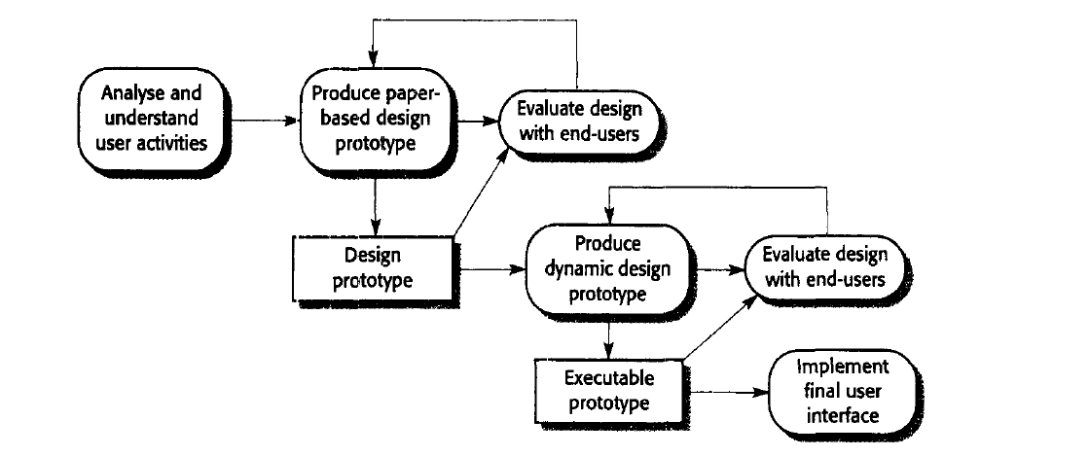
Design Process

Slide 15
User analysis
If you don't understand what users want to do with a system, then you have no realistic prospect of designing an effective user interface.
To develop this understanding, you may use techniques such as task analysis, ethnographic studies, user interviews and observations or, commonly, a mixture of all of these.

Slide 16
User analysis problems
Notations such as UML sequence charts may be able to describe user interactions and are ideal for communicating with software engineers.
However, other users may think of these charts as too technical and will not try to understand them.
It is very important to engage users in the design process, you therefore usually have to develop natural language scenarios to describe user activities.

Slide 17
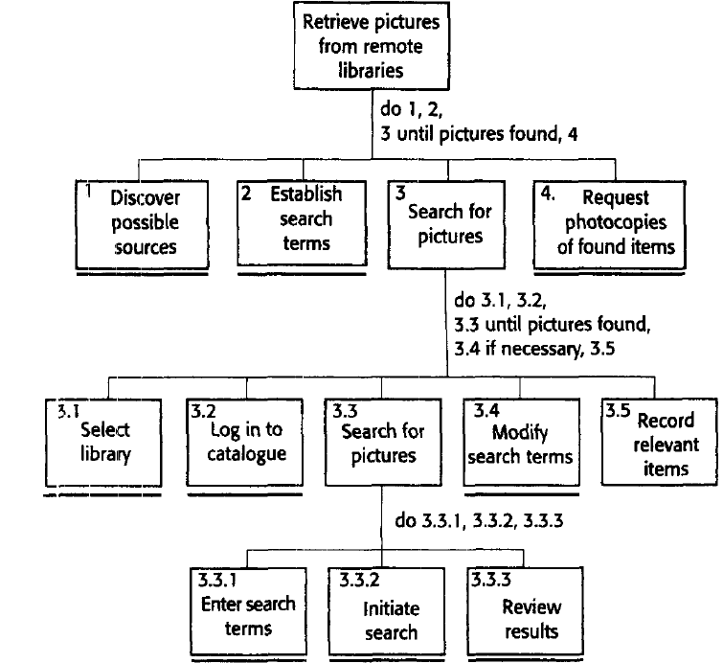
LIBSYS system Natural Language scenario

Slide 18
User interface prototyping
Evolutionary or exploratory prototyping with end-user involvement is the only practical way to design and develop graphical user interfaces for software systems.
Involving the user in the design and development process is an essential aspect of user-centred design,a design philosophy for interactive systems.

Slide 19
Prototyping process
adopt a two-stage prototyping process:
develop paper prototypes-mock-ups of screen designs-and walk through these with end-users.
develop increasingly sophisticated automated prototypes, then make them available to users for testing and activity simulation.

Slide 20
Approaches -user interface prototyping:
There are three approaches that you can use for user interface prototyping:
Script-driven approach
Visual programming languages
Internet based prototyping

Slide 21
Script-driven approach
In this approach, you create screens with visual elements, such as buttons and menus, and associate a script with these elements.
When the user interacts with these screens, the script is executed and the next screen is presented, showing them the results of their actions. There is no application logic involved.

Slide 22
Visual programming languages
Visual programming languages, such as Visual Basic, incorporate a powerful development environment, access to a range of reusable objects and a user-interface development system that allows interfaces to be created quickly, with components and scripts associated with interface objects.

Slide 23
Internet based prototyping
These solutions, based on web browsers and languages such as Java, offer a ready-made user interface
add functionality by associatmg segments of Java programs with the information

Slide 24
Interface evaluation
Interface evaluation is the process of assessing the usability of an interface and checking that meets user requirements. Therefore, it should be part of the normal verification and validation process for software systems

Slide 25
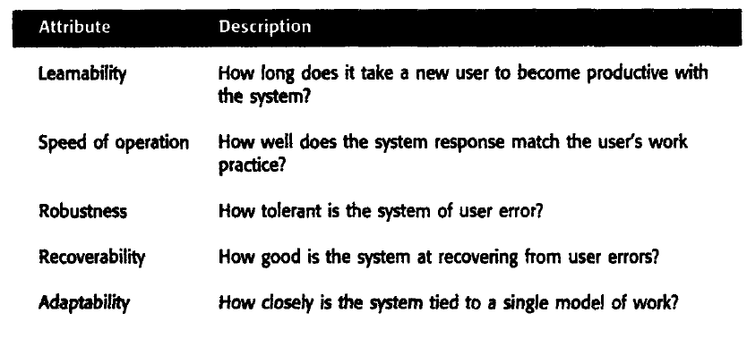
Usability attributes

Slide 26
user interface evaluation
Questionnaires that collect information about what users thought of the interface;
Observation of users at work with the system and 'thinking aloud' about how they are trying to use the system to accomplish some task;
Video 'snapshots' of typical system use;
The inclusion in the software of code which collects information about the most used facilities and the most common errors.

Slide 27
Reference
Chapter 16; Software Engineering
Author Ian Sommerville

